Slide 1
The Problem Statement
What are the genres, release dates, and runtimes of the top 10% of profitable movies released in the past 10 years, with minimum net margins of 50%?
Notes:
This is the Main Problem Statement I created in which, i made the problem statement specific, measurable, actionable and well-scoped.

Slide 2
The Ghost Deck
Synthesis:
We must find out the differences and takeaways by comparing genres, release dates and runtime.
Overview Of Analysis:
Dependency of Release Dates
Role of Genres
Importance of Runtime
Release date :
Does Release Date affect the Revenue or Profit of a movie?
Different Genres:
Which type of genre movie carry should be factor of popularity in top 10% of Profitable Movies?
Runtime:
Does Runtime of a Particular Movie decide its Popularity or its Revenue?
Limitation 1:
The dataset which is Provided is unclean. To find the genre we used to be split the columns .
Limitation 2:
Some Where the values of budget and revenue are null which result to be in a wrong answer
Review of Next Step:
Trailer‘s are the best way show the Glimpses of the movie and create curiosity.
Notes:
This is the Ghost Deck I created after considering the Hypothesis and various sub issues.

Slide 3
Executive Summary:
The Key Differentiators between the top 10% movies by Profit released in the past 10 years with a minimum net margin of 50% are, in the order of significance:
The Release date of Movie
Movies releases in the summer season (Vacations) are likely to earn more than average except some outliers.
Runtime of Movies
Most Movies are of 124 minutes of length except for some distinct movies.
Genres provide various choices, thus creating different audiences.
Our Recommendation for a Movie to increase its Revenue and Popularity is to,
Release movies in Vacation time or Holiday time, People are freer this time.
Make Average Length Movies, Lengthy Movies are most likely to earn less and become boring to the Audiences.
Release movies according to the Genre, which people like more.
Notes:
This is the Executive summary which defines the problem and and have recommendations for the Board.

Slide 4
Data Analysis:
I performed a EDA (Exploratory data analysis) for this dataset and found out various bits of uncleaned data
there were many null (NA) values in Revenue and budget columns which is MCAR missingness.
Genres column is unspecified and one has clean the data using Python or R.
in data processing, I made a calculated field to calculate the top 10% movies by ∗profit and then filter out by †Net margin greater than 50%.
Insights were clearly stated in takeaways.
Notes:
∗profit = Revenue - Budget
†Net Margin = Profit/revenue * 100

Slide 5
Hypothesized biases and limitations:
To increase the revenue movies should carry Good Budget which would result in a good revenue.
Genres should be well chosen according to the age group of the population.
Limitation are like Provided dataset is not unclean and having lot of bad data .In genre we used to split the column before used in analysis.
Limitation are like Provided dataset also having some missing values in revenue’s and budget columns. which result in wrong analysis.
Notes:
I Consider all three biases : Data collection, data processing and Insights biases to figure out the limitations of the dataset.

Slide 6
Analysis:
In this Movie Dataset, we used to be found a movie on the given parameter like revenue, budget, genre, and popularity. So we must build some visualization in between in these parameters which helps us to reach the goal as we have built some relationship visualization in between Title of the movie and the revenue. That comes out to be very useful.
we also use comparison visualization which helps us to find the best movie in between the data of two top movies. we can also use distribution visualization to find the performance of a genre over the years. That how we performed visualization.
Next is how we manage the limitation in Dataset like missingness which is the biggest problem in this data set like to use genre in visualization we use to perform critical splitting of a column. Some movies have a missing budget, and some have missing revenue which creates missingness called missing at random. The homepage column is completely null which gives missing completely at the random type of missingness.
After normalization of the dataset by performing the listwise and pairwise deletion. we perform visualization actions that give us results. But errors are still there in our result because we perform some cleaning operation on the dataset.
That how we analyze the dataset and whole activities we used to perform on a given dataset.
Notes:
This is my well summarized Hypothesis.

Slide 7
Biases In Dataset:
In the given dataset we find out some movie having two genre which lead to to the selection Bias if we go dipper then there is also voluntary Bias is there in which data is voluntary selected from the data collection.
Here the revenue is also undercover bias which is used to be depend on the budget and performance of movie and lot of other factor.
Popularity of the movie also is undercover bias which depend on lot of factor revenue, Budget and the performance of the movie.
Notes:
Biases in dataset.

Slide 8
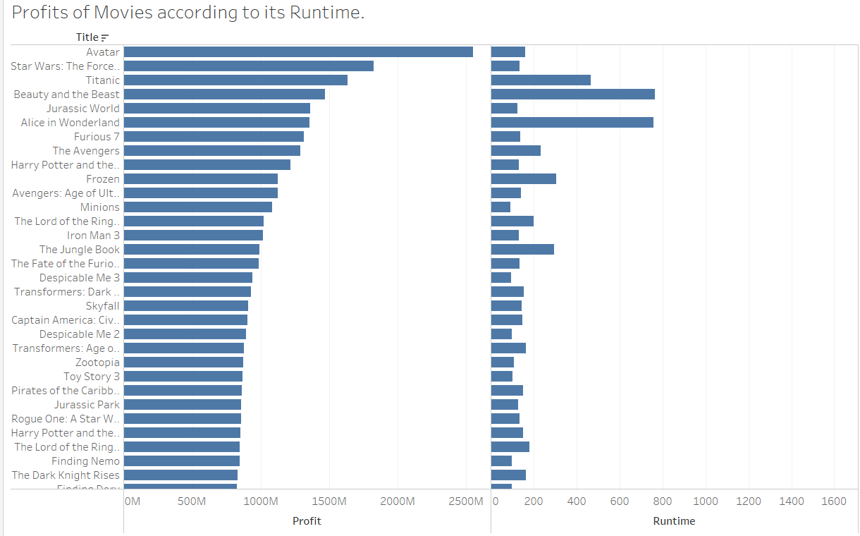
Visualization for Runtime:
Takeaways:
Most Movies are of average length, but their profit does not correlate with length truly, It is about the Popularity of the Movie.
Some Disney movies are quite lengthy , yet they are the top 10% profitable movies.
Distributions | Minutes
Min | 70
Q1 | 70
Q2 (Median) | 124
Mean | 147
Q3 | 201
Max | 1628
Notes:
This is first hypothesis for Runtime influencing the Profit of Movies.

Slide 9
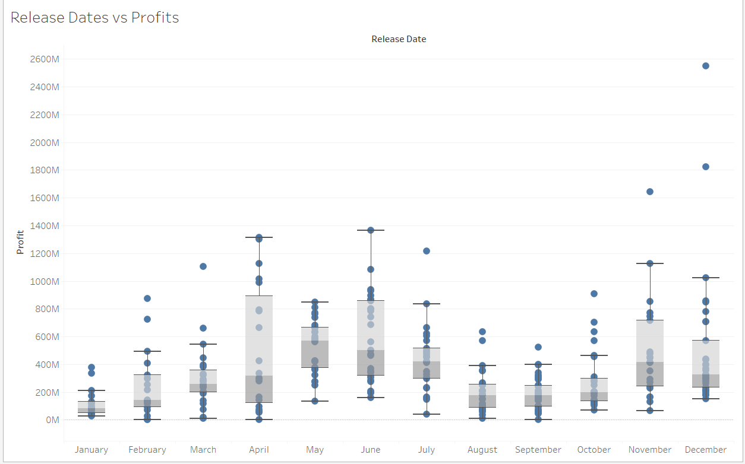
Visualization for Release Dates :
Takeaways:
Most Movies perform well in summer season – (Mar to June) as people are freer in this time.
In cases, Movies perform extremely well in Holidays season (Christmas) as seen in the month of December.
Notes:
Here, I made a Box Plot Graph for Release date as a factor for my question.
though i can’t use the Hypothesis of Genres affecting the profits but Genres section is not processed thus become a limitation for this analysis.

Slide 10
Thank you

